Slide 1
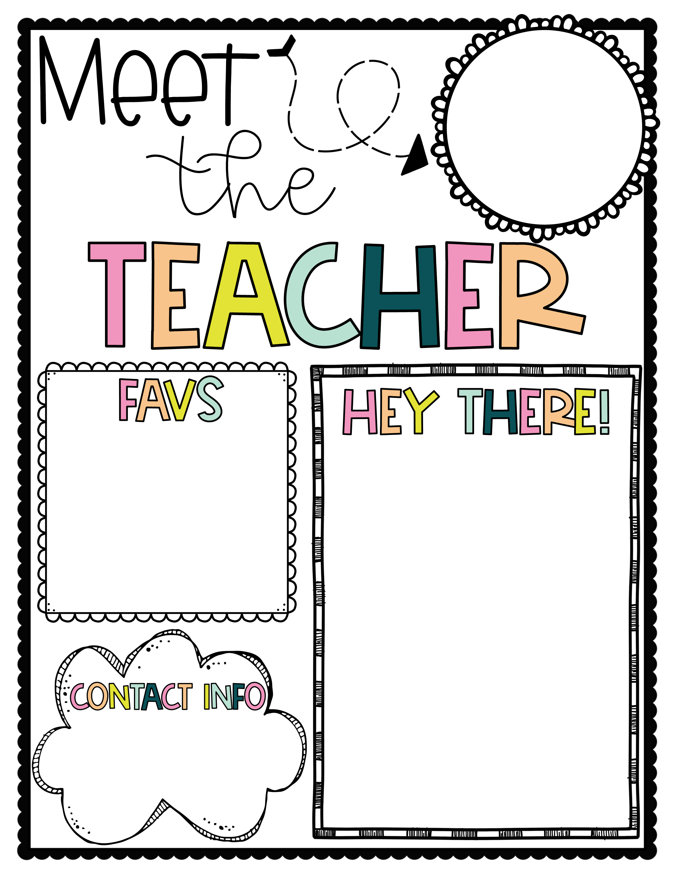
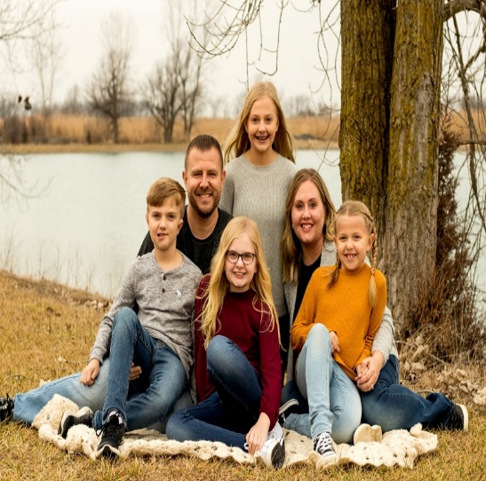
Fall weather
Reading
Football
Watching my kids
activities & sports
FRIENDS reruns
My name is Ashley Otto and I am excited to be your teacher this year.
I am originally from Ohio, we moved to Tallahassee in 2017. I graduated from The Ohio State University in 2006 with a BS in Middle Childhood Education and received my Masters & Reading Endorsement from The University of Findlay. I am certified to teach K-6 and ESE in Florida.
We have four children. Sienna a Sophomore & Peyton a Freshman, both at Chiles. Nathan in 6th at Deerlake & Tenley in 5th at Hawks Rise. In my free time, I drive my kids around to their activities and try to read whenever I can.
ottoa@leonschools.net
850-487-4733

